Slide 1
Sales Dashboard

Slide 2
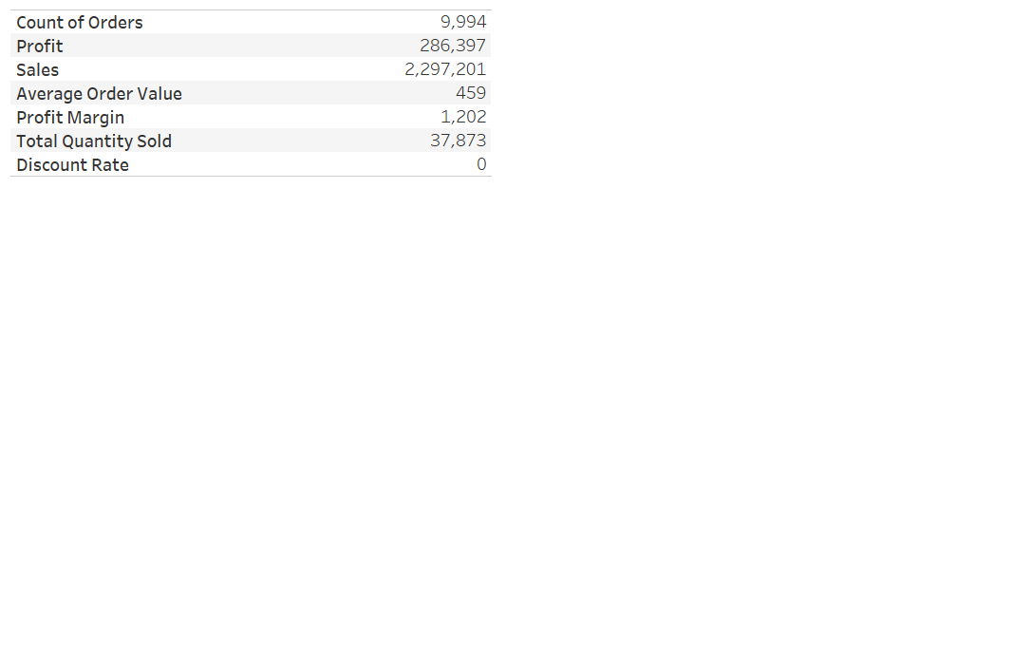
Primary KPIs

Slide 3
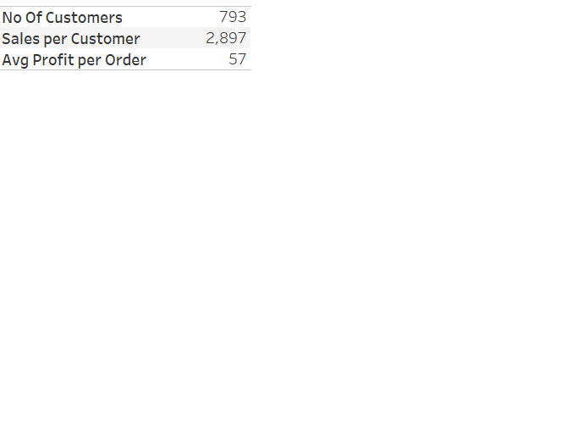
Customer KPIs

Slide 4
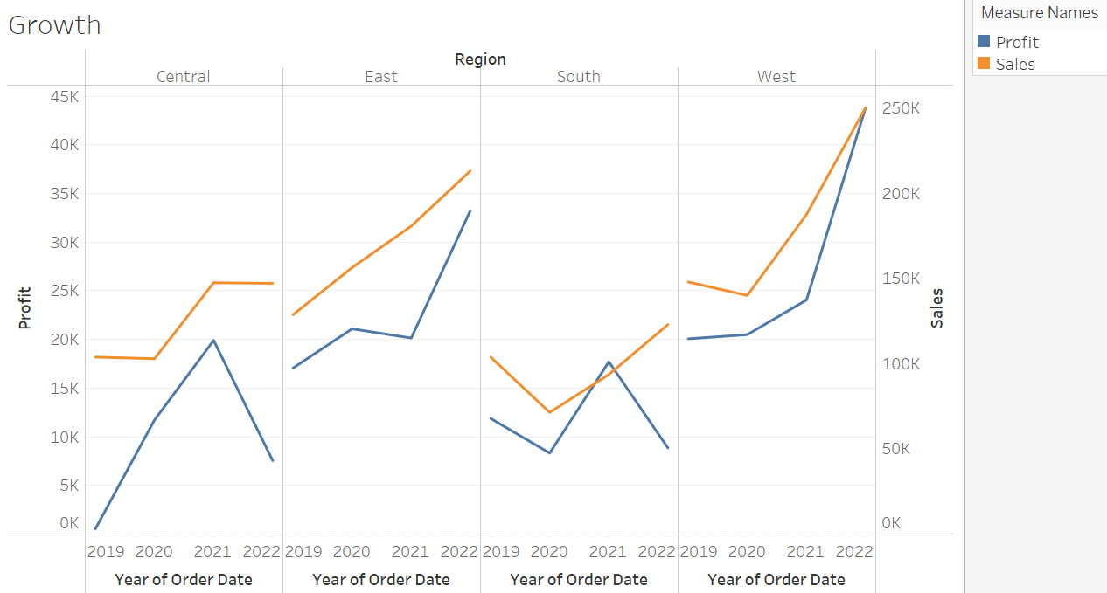
Growth By Region

Slide 5
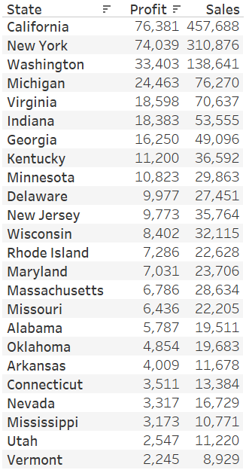
Performance by State

Slide 6
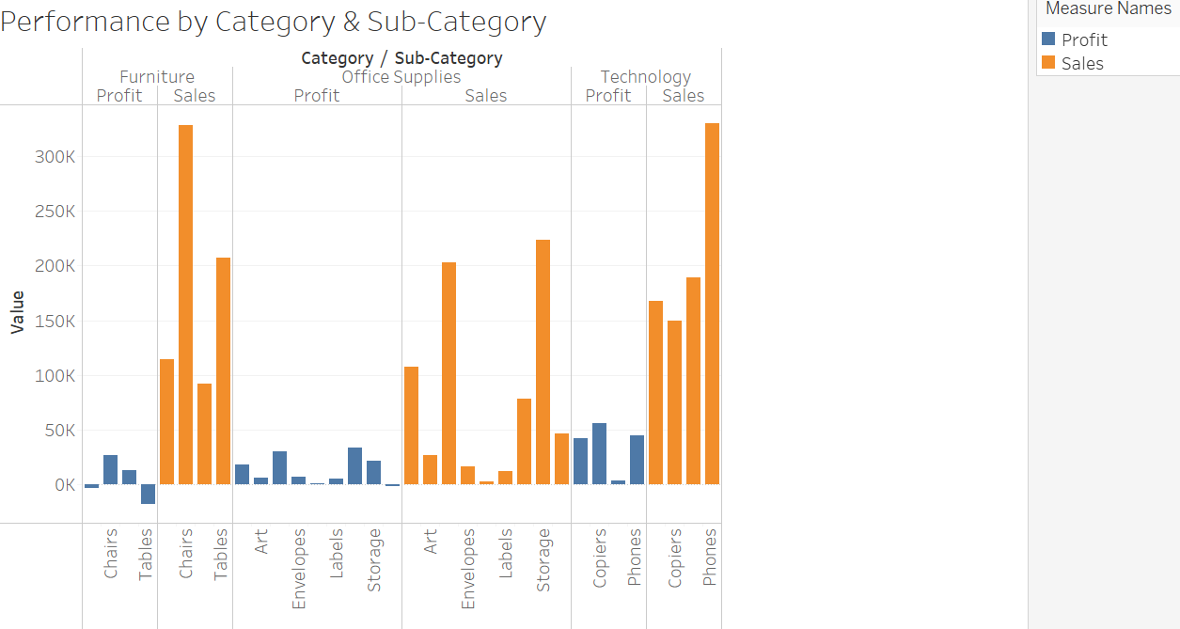
Performance by Category & Sub-Category

